Slide 1

European City Statistics - Prospects for the Future
Teodóra Brandmüller
Eurostat, Unit E4 Regional statistics and
geographic information unit
SmartStatistics4SmartCities
Kalamata, October 2018

Slide 2

Notes:
Maximilien_Luc:e Montmartre, de_la_rue_Cortot,_vue_vers_saint-denis',_oil_on_canvas_painting,_c._1900
Throughout history, cities have been at the centre of change, from the spread of Greek and Roman civilizations, through the Italian renaissance period, to the industrial revolution in the United Kingdom.
There are considerable differences in the size and spatial distribution of urban developments across the EU Member States. Each of the EU Member States has a distinctive history of territorial developments.

Slide 3
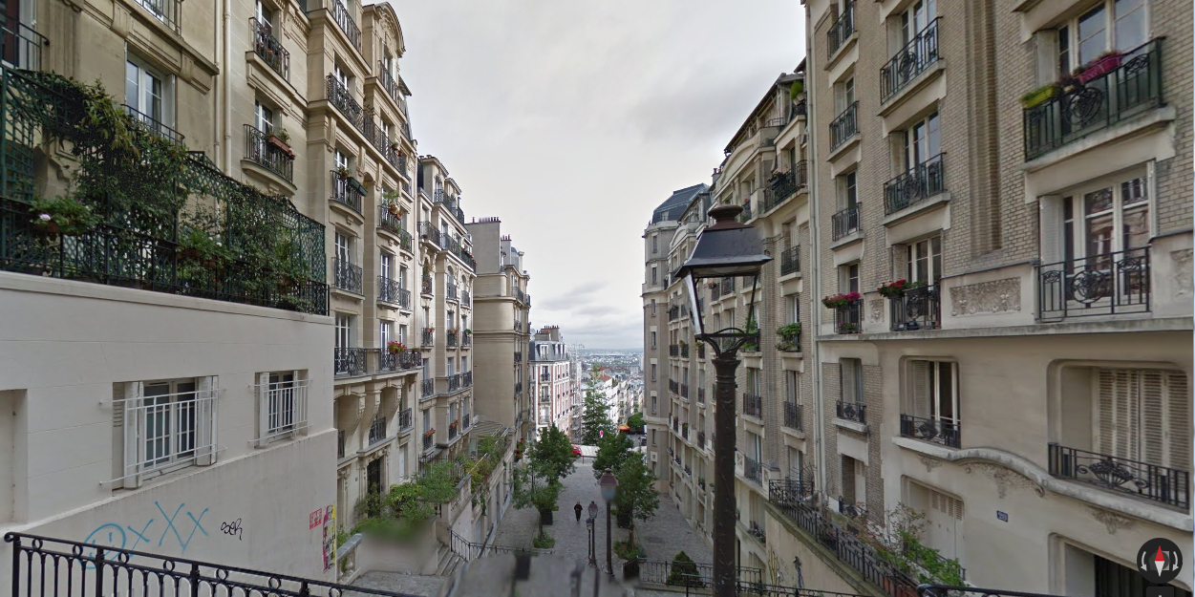

Slide 4
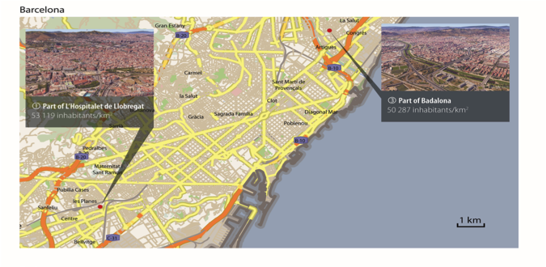
... the most dense 1 km² grid cell
Hospitalet de Llobregat

Slide 5
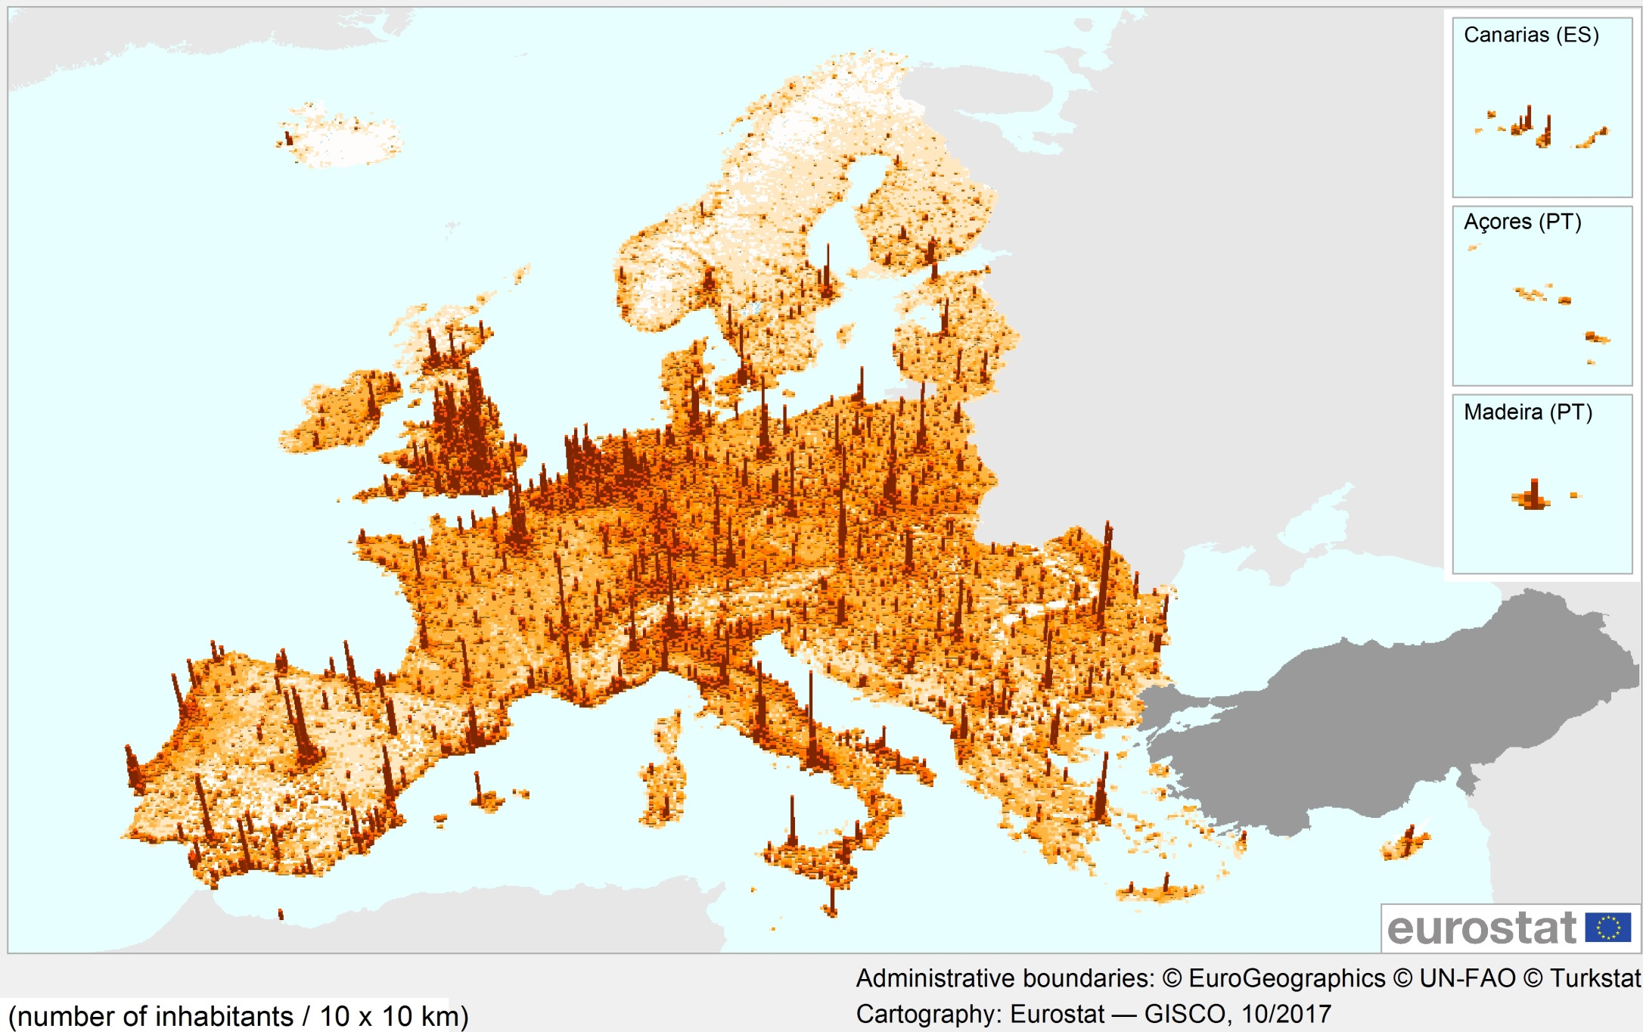
Population density based on the GEOSTAT population grid, 2011
Notes:
The GEOSTAT population grid provides statistical and geospatial information for each of the close to 4.5 million km² of area covered by the EU-28. The average population density for the whole of the EU-28 was 116.4 inhabitants per km²; however, less than half of the EU’s total area (44 % or 1.95 million km²) was actually inhabited.
Less than 3% of the EU population lives in a grid cell with population density close to the average (100-149 persons/km)
Approx 2/3 of the EU population lives in grid cells with more than 1000 inh/km

Slide 6
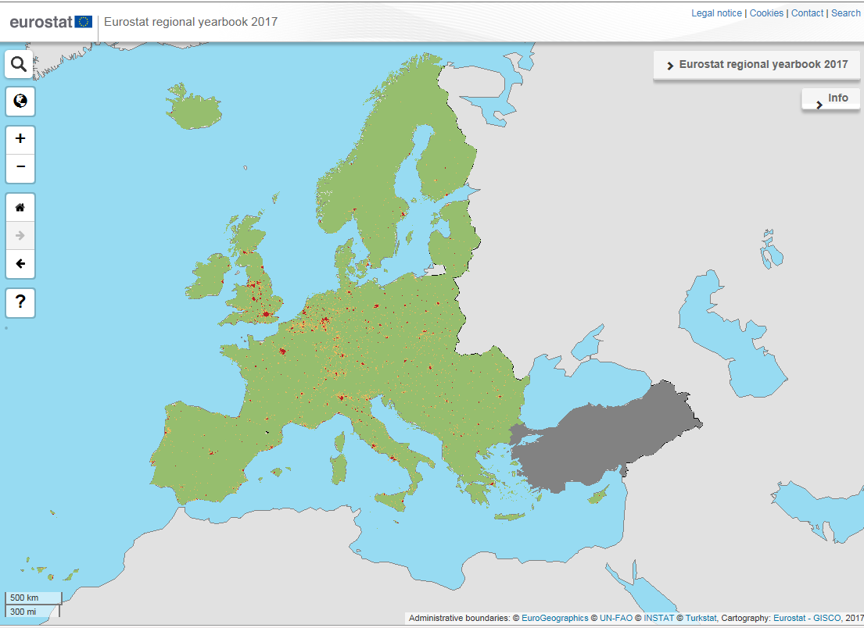
http://ec.europa.eu/eurostat/statistical-atlas/gis/viewer
Notes:
Type of clusters (population grid 2011)
Cluster types, based on 1 km² grid cells (¹)
Urban centre (High-density clusters): a cluster of contiguous grid cells of 1 km² with a density of at least 1 500 inhabitants per km² and a minimum population of 50 000.
Urban clusters: a cluster of contiguous grid cells of 1 km² with a density of at least 300 inhabitants per km² and a minimum population of 5 000.
Rural grid cells: grid cells of 1 km² outside urban and high-density clusters.

Slide 7
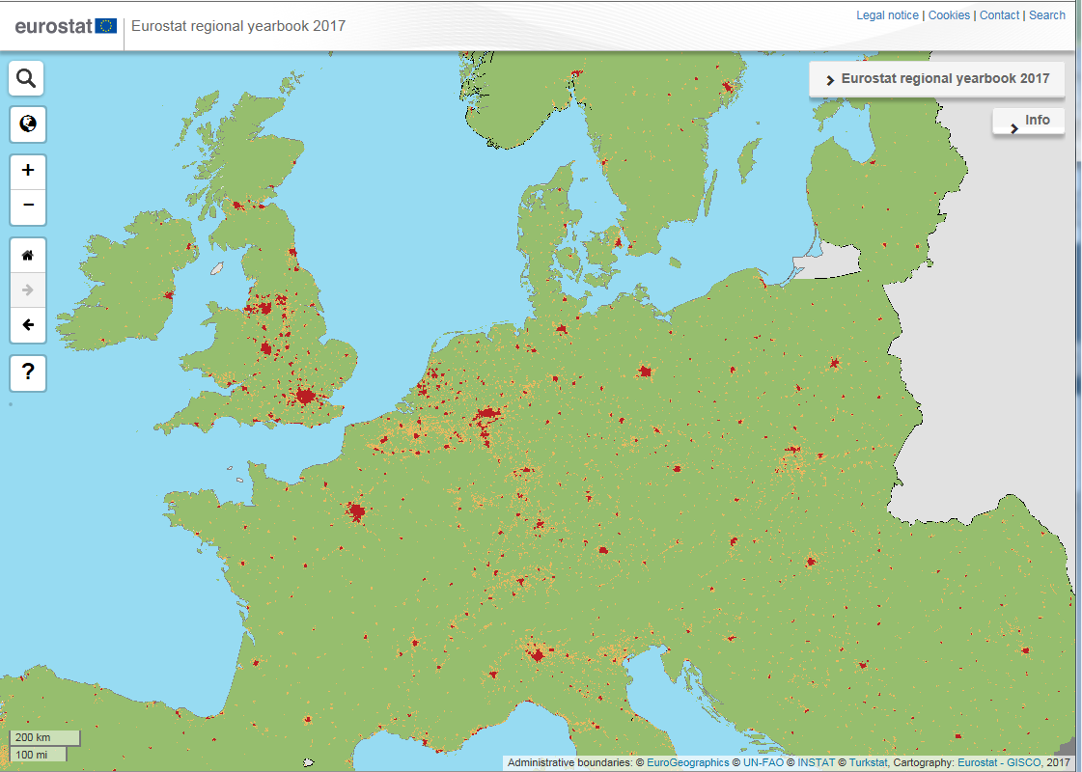
http://ec.europa.eu/eurostat/statistical-atlas/gis/viewer
Notes:
http://ec.europa.eu/eurostat/statistical-atlas/gis/viewer/?chapter=09&mids=BKGCNT,C99M01&o=1,1&ch=C09,TRC,TYP&center=51.57063,9.06575,4&lcis=C99M01&#

Slide 8
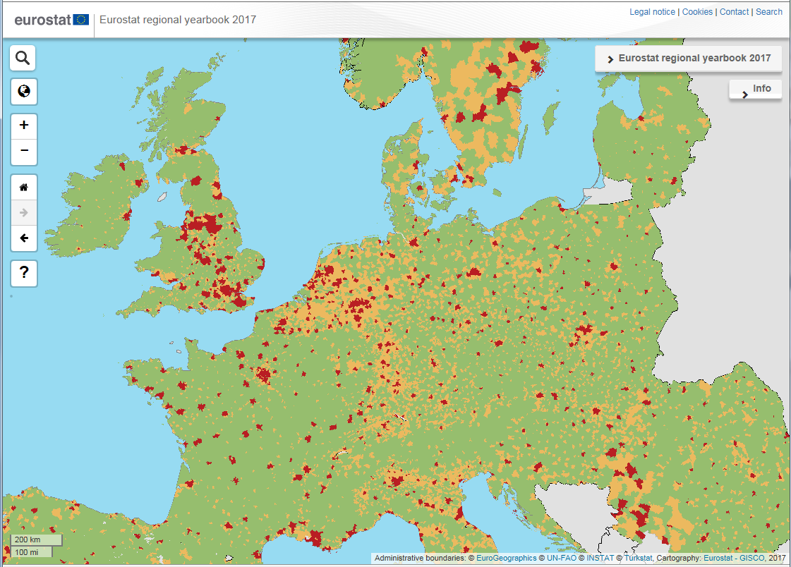
http://ec.europa.eu/eurostat/statistical-atlas/gis/viewer
Notes:
Cities (Densely populated areas: at least 50 % of the population lives in urban centres)
Towns and suburbs (Intermediate density areas: less than 50 % of the population lives in rural grid cells and less than 50 % of the population lives in urban centres)
Rural areas (Thinly populated areas: more than 50 % of the population lives in rural grid cells)

Slide 9
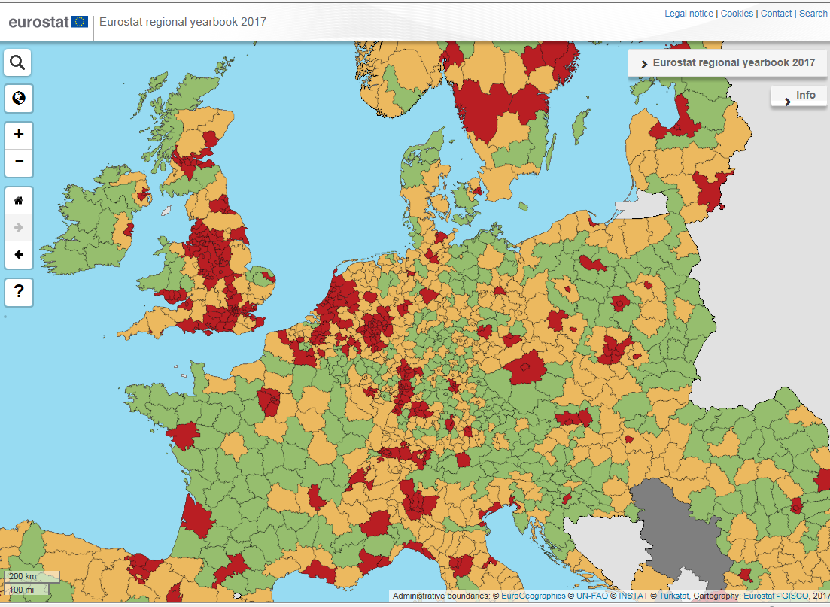
http://ec.europa.eu/eurostat/statistical-atlas/gis/viewer
Notes:
Urban-rural typology for NUTS level 3 regions
Predominantly urban regions (rural population is less then 20% of the total population)
Intermediate regions (rural population is between 20% and 50% of the total population)
Predominantly rural population (rural population is 50% or more of the total population)

Slide 10
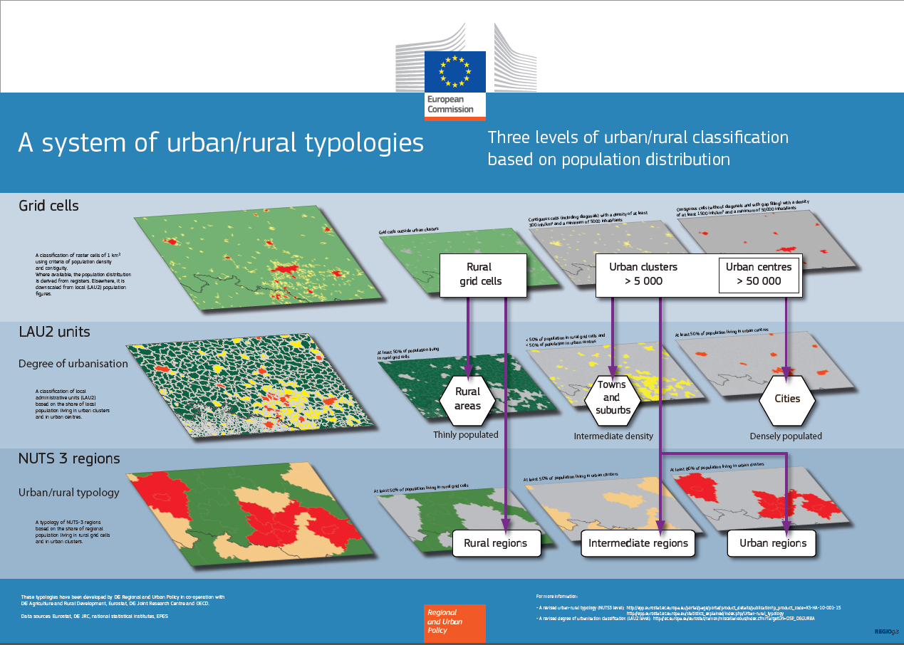
Notes:
Definition of rural area
The first step is to identify populations in rural areas: 'rural areas' are all areas outside urban clusters. 'Urban clusters' are clusters of contiguous¹ grid cells of 1 km² with a density of at least 300 inhabitants per km² and a minimum population of 5 000.
Classification of the regions
In the second step, NUTS 3 regions are classified as follows, on the basis of the share of their population in rural areas:
'Predominantly rural' if the share of the population living in rural areas is higher than 50
'Intermediate' if the share of the population living in rural areas is between 20 and 50
'Predominantly urban' if the share of the population living in rural areas is below 20
To resolve the distortion created by extremely small NUTS 3 regions, for classification purposes regions smaller than 500 km² are combined with one or more of their neighbours.
Presence of city
In a third step, the size of the urban centres in the region is considered.
A predominantly rural region which contains an urban centre of more than 200 000 inhabitants making up at least 25% of the regional population becomes intermediate.
An intermediate region which contains an urban centre of more than 500 000 inhabitants making up at least 25% of the regional population becomes predominantly urban.

Slide 11
Characteristics of the definition
Population based definition
Starts from the population grid
  Avoids distortions caused by large variations in the area of administrative territorial units
Uses three categories at three spatial levels
Has a legal recognition: Regulation of the European Parliament and of the Council amending Regulation (EC) No 1059/2003 as regards the territorial typologies
Enables the collection, compilation and dissemination of harmonised statistics
Allows better targeted policy-making at EU level

Slide 12
Prospects for the future
Use the harmonised and legally recognised statistical territorial definitions (grid, city, town and suburbs, etc.) to produce more spatially disaggregated statistics

Slide 13
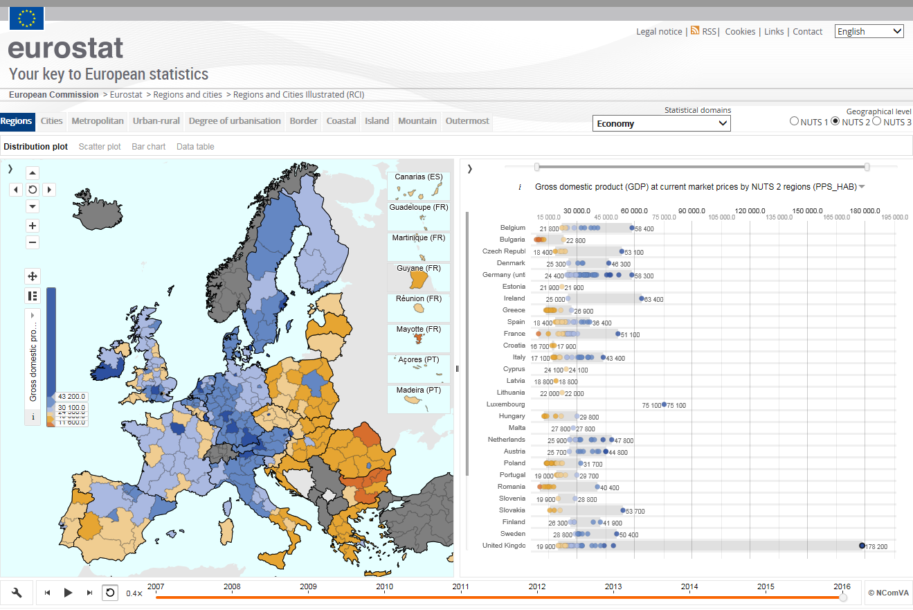

Slide 14
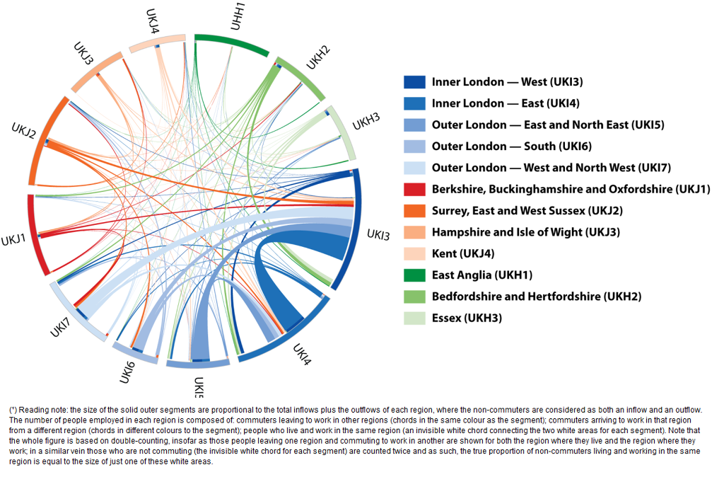
Commuter flows of London
Notes:
Inner London - West was, by far the most popular destination for commuters in the United Kingdom, with almost 1.5 million persons commuting into this region
Reading note: the size of the solid outer segments are proportional to the total inflows plus the outflows of each region, where the non-commuters are considered as both an inflow and an outflow. The number of people employed in each region is composed of: commuters leaving to work in other regions (chords in the same colour as the segment); commuters arriving to work in that region from a different region (chords in different colours to the segment); people who live and work in the same region (an invisible white chord connecting the two white areas for each segment). Note that the whole figure is based on double-counting, insofar as those people leaving one region and commuting to work in another are shown for both the region where they live and the region where they work; in a similar vein those who are not commuting (the invisible white chord for each segment) are counted twice and as such, the true proportion of non-commuters living and working in the same region is equal to the size of just one of these white areas.

Slide 15
Prospects for the future
Complement existing territorial classifications with more flexible, more functional statistical geography

Slide 16
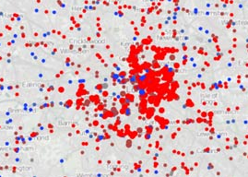
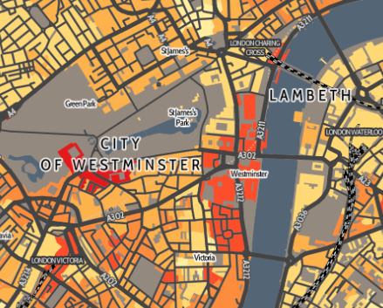
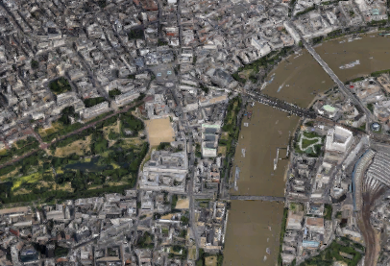
Data sources for city statistics
Survey data
Admin data
"Real world"
Notes:
Alfred Korzybski
Alfred Habdank Skarbek Korzybski was a Polish-American independent scholar who developed a field called general semantics, which he viewed as both distinct from, and more encompassing than, the field of semantics. Wikipedia
Born: July 3, 1879, Warsaw, Poland
Died: March 1, 1950, Lakeville, Salisbury, Connecticut, United States
There are two ways to slide easily through life: to believe everything or to doubt everything; both ways save us from thinking.
The map is not the territory.
If a psychiatric and scientific inquiry were to be made upon our rulers, mankind would be appalled at the disclosures.

Slide 17
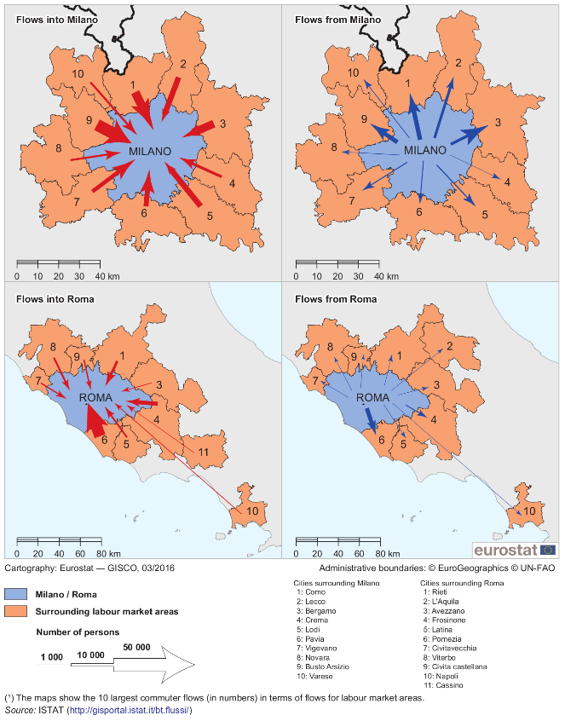
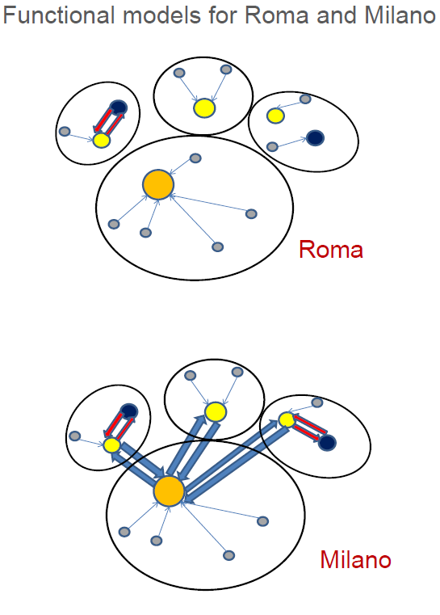
Commuter flows of Milano and Rome
Source: Presentation of L. Franconi at the Workshop on Labour Market Areas, ISTAT
Notes:
Labour market areas are defined by Eurostat as ‘economically integrated regions within which residents can find jobs in a reasonable commuting distance, or can change their employment without changing their place of residence’. They are designed to allow new analyses of socio-demographic characteristics and to overcome the traditional constraints of regional statistics, as administrative boundaries often result from historical circumstances rather than real world social and economic realities.
The method used by Eurostat and national statistical institutes (NSIs) is to combine administrative and functional approaches. Eurostat supports the ongoing development of a methodology through a system of grants, while the participating NSIs test the application of methods nationally. The goal is to arrive at a harmonised EU-wide definition for labour market areas so that these statistics can be used to bring light to the effects of commuting and to assist in the design of employment, labour mobility and urban planning policies.
An analysis of labour market areas allows the degree of economic integration between places to be measured by the extent to which workers are willing and able to commute between two places. This may be particularly relevant for analysing city centres to which a considerable number of people commute every day, or satellite cities and suburbs which provide additional employment capacity to nearby urban centres.
For more information: https://ec.europa.eu/eurostat/cros/content/labour-market-areas_en
Map 3 shows the 10 largest labour market areas in terms of commuter numbers both to and from Milano and Roma. There were, on average, 213 thousand people who commuted into Milano each day in 2011, equivalent to 5.8 % of its total population, while the flow of commuters into Roma was less than half this level, at around 100 thousand or 2.9 % of its total population.
The largest flows of commuters into Milano were from Busto Arsizio, Como and Bergamo, although the origin of commuters was quite evenly distributed around the city in a radial pattern. On the other hand, almost half (44 %) of the commuters arriving in Roma each day were from Pomezia — a relatively new urban development to the south of the capital. It can also be noted that an average of 2 709 people commuted from Napoli to Roma
Roma: monocentric functional region both inside and outside: absence of relationships with other regions.
Milano: urban network of relationships - Nodal polycentrism • the center, Milano, exchanges flows with Bergamo, Busto Arsizio and Como, themselves nodes for their own regions.

Slide 18

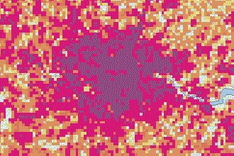
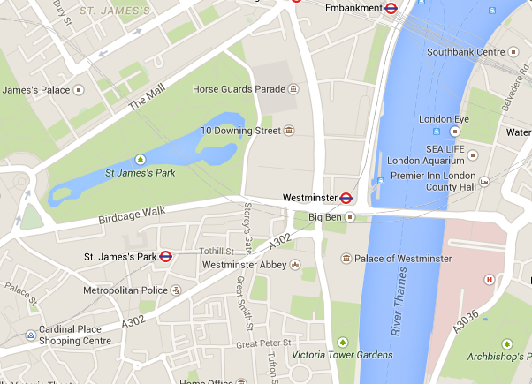
Data sources for city statistics
Big data
Grid data
Survey data
Admin data
Geographical level
"Real world"
Notes:
Alfred Korzybski
Alfred Habdank Skarbek Korzybski was a Polish-American independent scholar who developed a field called general semantics, which he viewed as both distinct from, and more encompassing than, the field of semantics. Wikipedia
Born: July 3, 1879, Warsaw, Poland
Died: March 1, 1950, Lakeville, Salisbury, Connecticut, United States
There are two ways to slide easily through life: to believe everything or to doubt everything; both ways save us from thinking.
The map is not the territory.
If a psychiatric and scientific inquiry were to be made upon our rulers, mankind would be appalled at the disclosures.

Slide 19
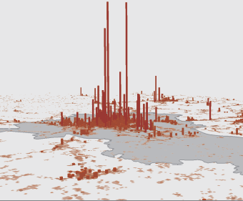
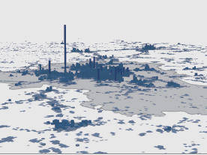
Day and night-time population
Ljubljana
Administrative data calibrated by patterns observed in mobile phone network data
Source: Statistical Office of the Republic of Slovenia
Notes:
Experimental statistics on day-time and night time population density based on administrative data calibrated by the hourly patterns observed in mobile phone network data. Mobile data analysis made use of signals transmitted between mobile devices and transmitter stations of the second largest Slovene Mobile provider for the period May-October 2014
The influx of commuters into a city each morning can considerably change the number of persons who are active within its territorial boundaries. Map 2 contrasts day-time and night-time population density for Ljubljana (the capital of Slovenia) during the period 1 May–31 October 2014; the day-time population having been measured at lunchtime (12:00h–13:00h), while the night-time population was measured after most people had gone to bed (00:00h–01:00h). The information presented is based on administrative data (for the day-time population) and a central population register (for the night-time population) and was calibrated using hourly patterns observed from mobile phone data.
The general pattern of considerably more people being in the city centre during the day-time is clearly evident when contrasting the two maps, whereas the night-time population was greater in some subcity districts away from the city centre, as well as in some of the surrounding areas. The highest level of population density during the day-time was recorded for a grid cell covering some business entities where the majority of employees were recorded as working in the Ljubljana headquarters, while the highest level of population density during the night-time was recorded for a grid cell containing an administrative building for a student campus (thereby also suffering from a similar measurement issue).

Slide 20
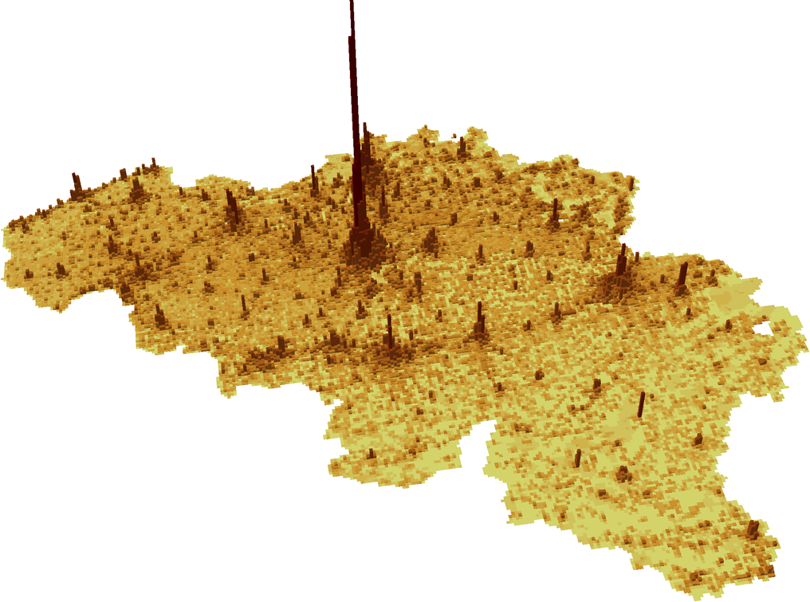
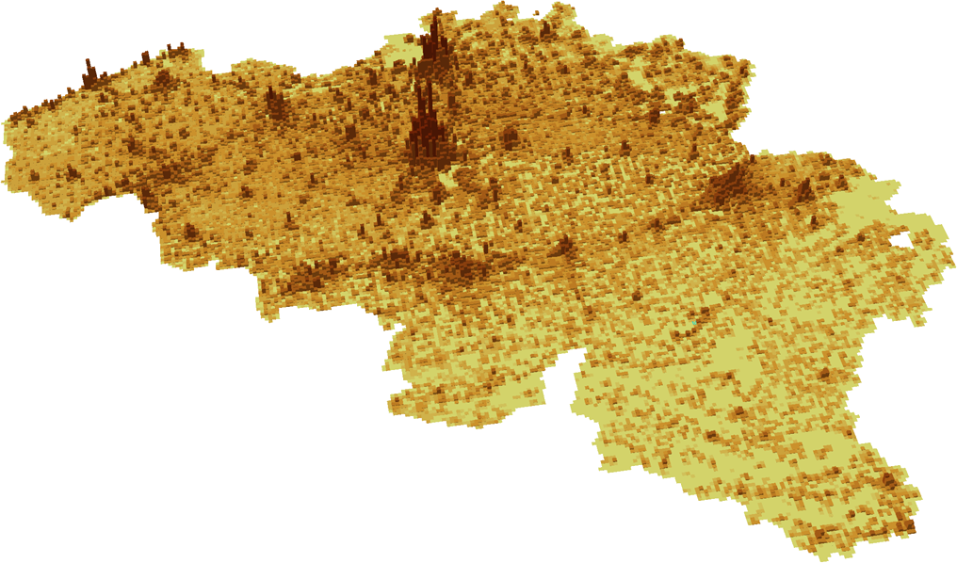
Where are people during a typical weekday?
Belgium
Source: Joint project of Statistics Belgium, Proximus and Eurostat
Notes:
New computational models must be adopted
between private and public actors
to guarantee mutually trusted of the process
Work package led by Spain
Aim:
produce estimates of day-time populations as a mature official statistical product
gather the current experiences about data access to mobile phone data in the ESS,
(ii) to obtain access to the mobile phone data for their exploitation in the 2nd period of the project and
(iii) to propose some specific complementary potential outputs for official statistics based on this source of information.”
Workshop with Telcos in 2017

Slide 21
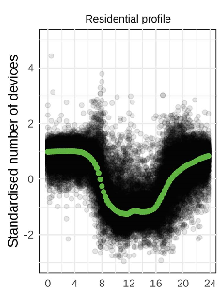
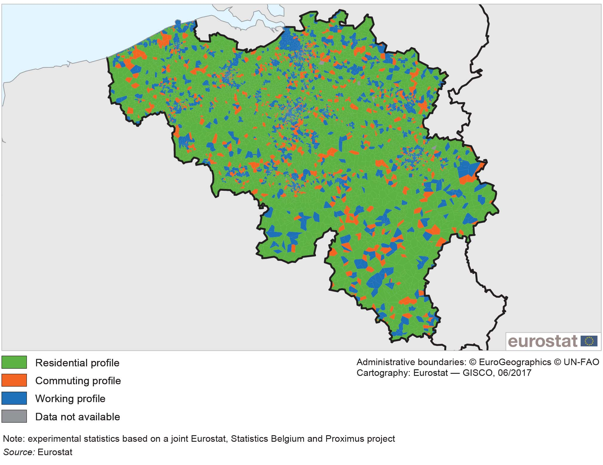
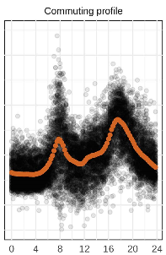
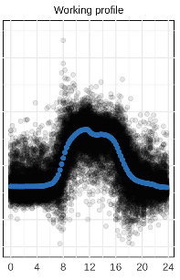
Classification of the territory: residential, commuting and working areas profiles
Belgium
Notes:
Big data project — Belgian mobile phone data
Big data refers to large and very detailed digital trails left by people in their use of IT systems or detailed digital information that is captured by sensors. Examples include the information recorded while people browse the internet or connect to a mobile telecommunications network, or sensors that may be found along the side of main roads (which may be used to detect, for example, traffic volumes or carbon dioxide emission levels). These data can be used to identify patterns and analyse human behaviour.
Mobile phone networks are based on a cellular system with each cell served by a base station with a communications tower and a set of antennas. Statistics Belgium and Eurostat have worked with Proximus (a Belgian mobile network operator) to investigate the potential of data from mobile networks that are stored as part of an operator’s telecommunications system, for example, data on when and where people connect to a network through a mobile device.
The work started with the development of a map of spatial areas approximating the mobile network cells, independent of the telecommunications technology (for example, 2G, 3G or 4G). An analysis was conducted based on the number of devices connected to the base station of each cell at different times of the day during two week days. Each area was classified into one of three profiles: a residential profile where the number of connections was above average at night and below average during the day; a working profile where the reverse situation was observed; and a commuting profile where there were two peaks (around 08.00 h and 18.00 h). The resulting maps showed a coherent picture, with most of the country made up of residential zones interspersed with a few working zones and commuting zones usually bridging these.

Slide 22
Prospects for the future
Implement new and improved statistical products based on administrative sources and big data for smart statistics
Notes:
To promote geocoding of statistical unit records where appropriate using national point based geocoding infrastructure. Geocoding is the process of locating people and businesses using addresses or other location information and is one of the key principles of the Statistical Geospatial Framework. NSIs should maintain the necessary tools and address data or have access to national geocoding services. Specifically NSIs should aim for persistent geocoding of survey samples, allowing for efficiency gains in the setup and analysis of surveys such as the LFS, SILC, etc.
To implement consistently across the ESS the methodological guidelines for geospatial information management and geospatial statistics. The GEOSTAT GEOSTAT projects have developed a methodological foundation based on this Statistical Geospatial Framework for managing geospatial information in statistical production and generate geospatial statistics. If the GEOSTAT methodological guidelines will be implemented fully in the ESS, geospatial statistics will be harmonised and comparable, e.g. as regards the spatial resolution, temporal resolution, accuracy of location and size and type of output geographies. As an example all NSIs will be able to produce population grids with the same grid cell size.
To promote geocoding of statistical unit records where appropriate using national point based geocoding infrastructure. Geocoding is the process of locating people and businesses using addresses or other location information and is one of the key principles of the Statistical Geospatial Framework. NSIs should maintain the necessary tools and address data or have access to national geocoding services. Specifically NSIs should aim for persistent geocoding of survey samples, allowing for efficiency gains in the setup and analysis of surveys such as the LFS, SILC, etc.
To promote geospatial core data production as defined by the UN-GGIM: Europe, and INSPIRE for instance geospatial data on buildings, addresses, transport networks and administrative units. Those data will be used to geo-code statistical and administrative data sources, or disaggregate SDG indicators such as on land use and accessibility to services.

Slide 23
Measuring access to public transport
Who has easy walking access to a public transport stop?
  Maximum 5 minutes walk to bus or tram stop
  Maximum 10 minutes walk to train or metro
Walking distance calculated using a street network
  Density of the street network matters
  Obstacles for pedestrians are taken into account
For each catchment area around a stop: total number of departures and number of inhabitants
Notes:
At 5 km/hour : 5 minutes is approx. 400 meter, 10 minutes approx. 800 meter

Slide 24
Frequency classes
5 groups based on access and departure frequency
 |  | Metro and train
 |  | High frequency (> 10 departures/hour) | Medium frequency (between 4 and 10 departures/hour) | Low frequency (less than 4 departures/hour) | No services
Bus and tram | High frequency (> 10) | VERY HIGH | HIGH | HIGH | HIGH
 | Medium frequency (4 to 10) | HIGH | MEDIUM | MEDIUM | MEDIUM
 | Low frequency (< 4) | HIGH | MEDIUM | LOW | LOW
 | No services | HIGH | MEDIUM | LOW | NO ACCESS

Slide 25
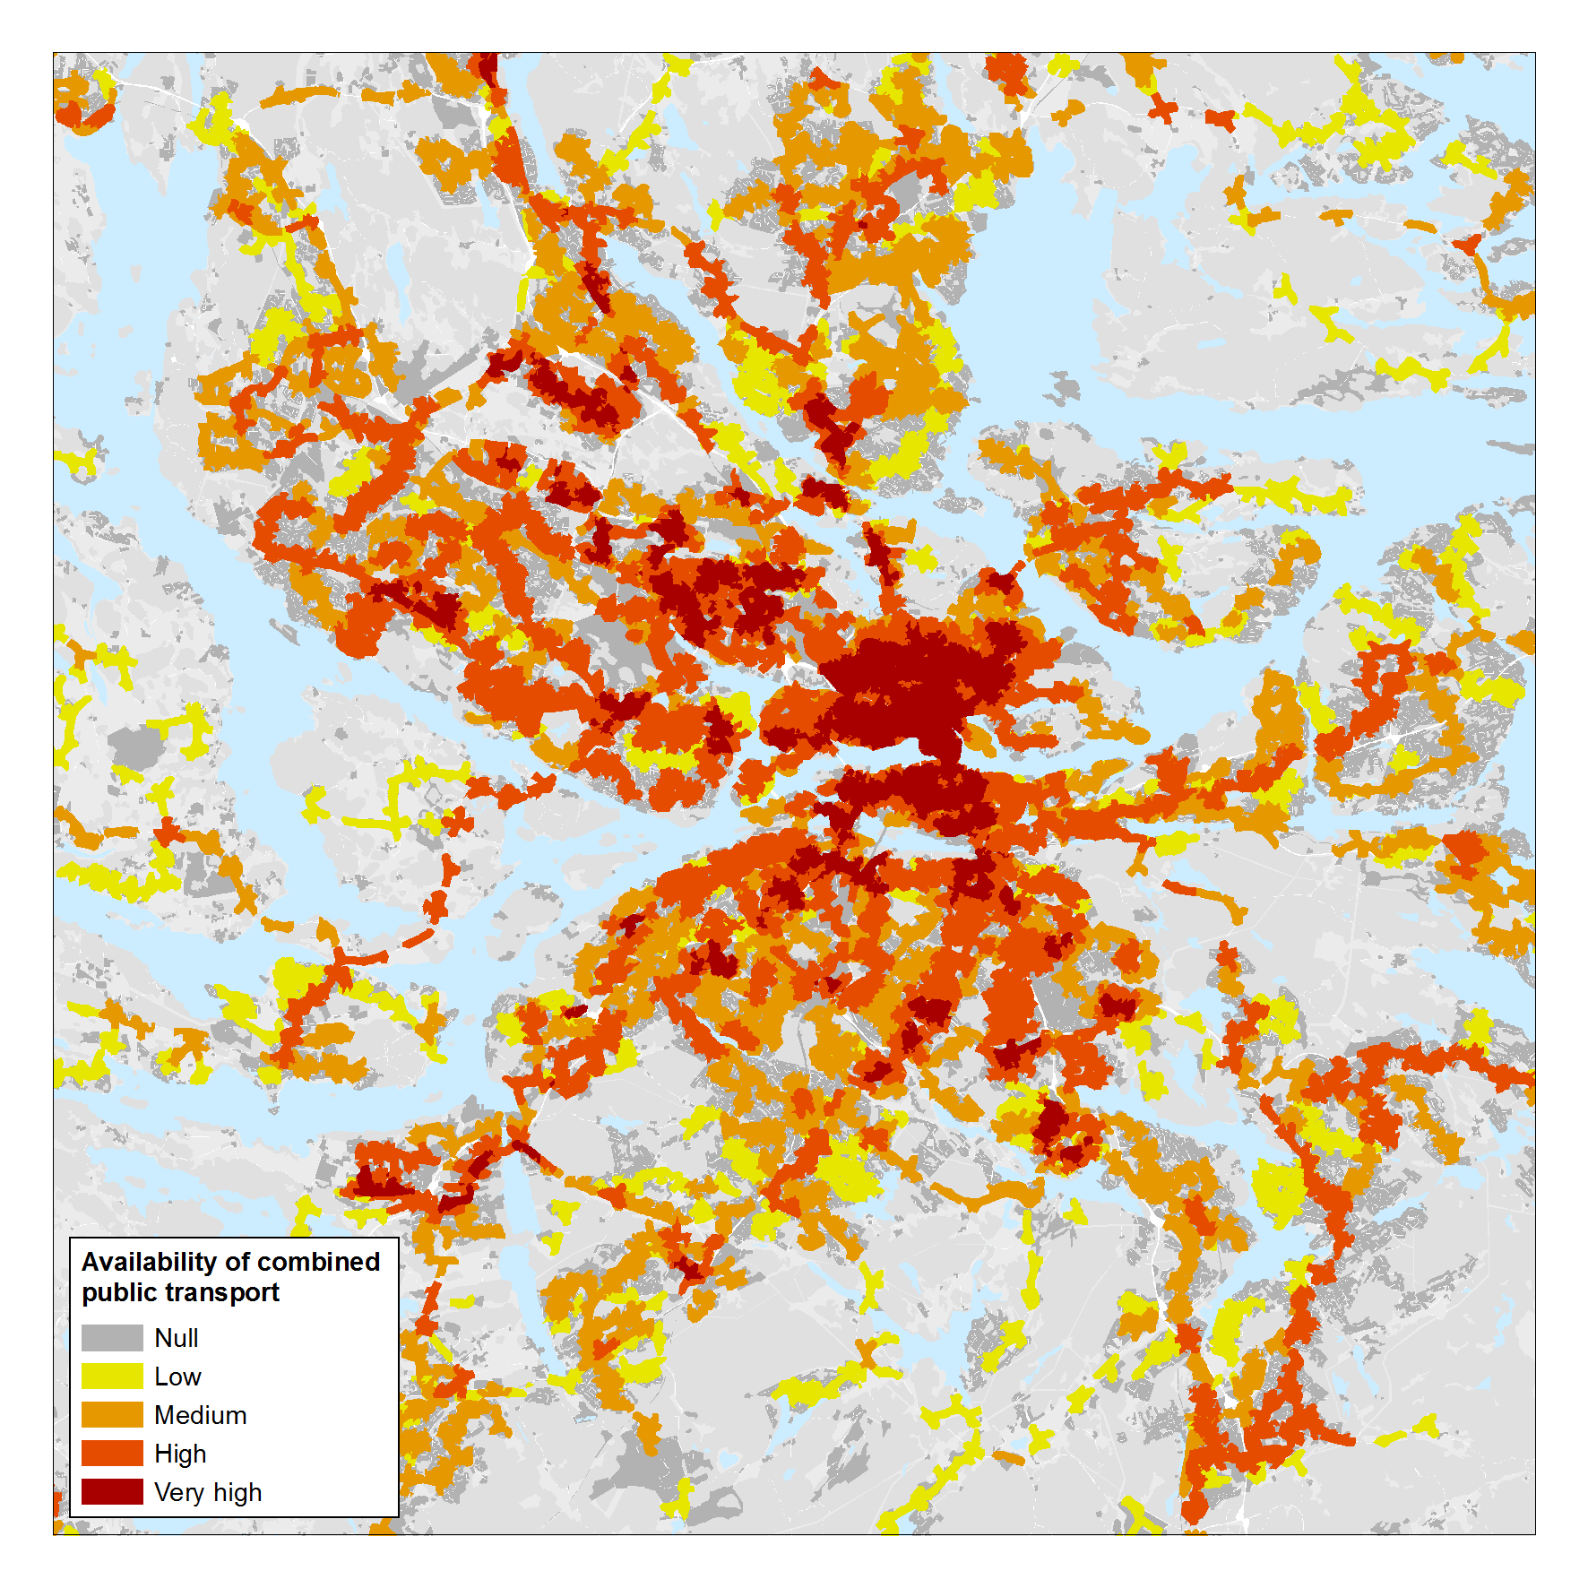
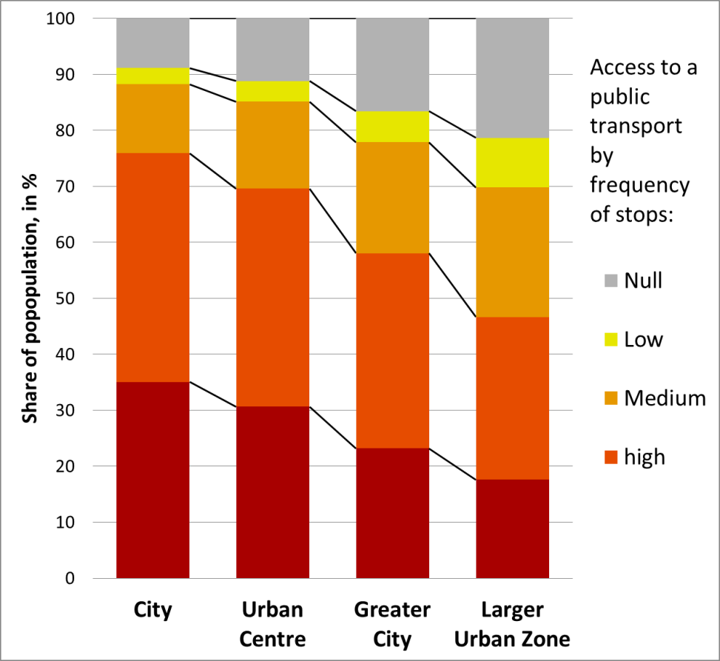
Stockholm: areas and population by access to public transport and its frequency
Source: H. Poelman, L. Dijkstra: Measuring access to public transport in European cities, Regional Working Paper 2015
Notes:
H. Poelman, L. Dijkstra: Measuring access to public transport in European cities, Regional Working Paper 2015

Slide 26
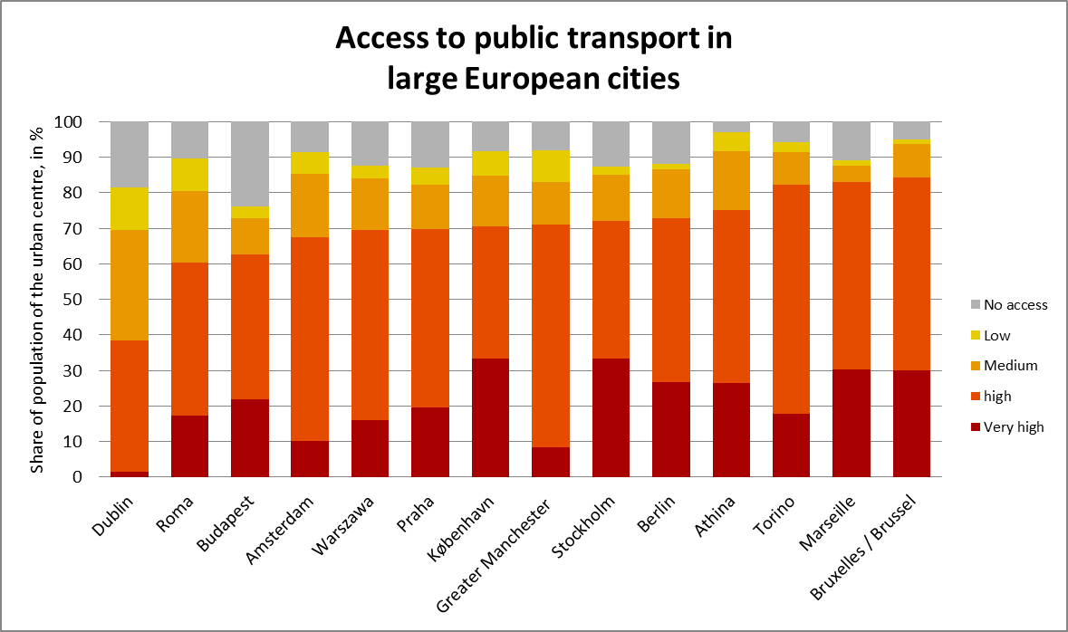

Slide 27
Conclusions
Implement new and improved statistical products based on administrative sources and big data for smart statistics
Complement existing territorial classifications with more flexible, more functional statistical geography
Use the harmonised and legally recognised statistical territorial definitions (grid, city, town and suburbs, etc.) to produce more spatially disaggregated statistics
Notes:
To promote geocoding of statistical unit records where appropriate using national point based geocoding infrastructure. Geocoding is the process of locating people and businesses using addresses or other location information and is one of the key principles of the Statistical Geospatial Framework. NSIs should maintain the necessary tools and address data or have access to national geocoding services. Specifically NSIs should aim for persistent geocoding of survey samples, allowing for efficiency gains in the setup and analysis of surveys such as the LFS, SILC, etc.
To implement consistently across the ESS the methodological guidelines for geospatial information management and geospatial statistics. The GEOSTAT GEOSTAT projects have developed a methodological foundation based on this Statistical Geospatial Framework for managing geospatial information in statistical production and generate geospatial statistics. If the GEOSTAT methodological guidelines will be implemented fully in the ESS, geospatial statistics will be harmonised and comparable, e.g. as regards the spatial resolution, temporal resolution, accuracy of location and size and type of output geographies. As an example all NSIs will be able to produce population grids with the same grid cell size.
To promote geocoding of statistical unit records where appropriate using national point based geocoding infrastructure. Geocoding is the process of locating people and businesses using addresses or other location information and is one of the key principles of the Statistical Geospatial Framework. NSIs should maintain the necessary tools and address data or have access to national geocoding services. Specifically NSIs should aim for persistent geocoding of survey samples, allowing for efficiency gains in the setup and analysis of surveys such as the LFS, SILC, etc.
To promote geospatial core data production as defined by the UN-GGIM: Europe, and INSPIRE for instance geospatial data on buildings, addresses, transport networks and administrative units. Those data will be used to geo-code statistical and administrative data sources, or disaggregate SDG indicators such as on land use and accessibility to services.

Slide 28

Thank you for the attention!
http://ec.europa.eu/eurostat/web/regions-and-cities/overview
Questions:
ESTAT-REGIO@ec.europa.eu

Slide 29
Acknowledgments
Eurostat Big Data Task Force
Eurostat GISCO Team
Eurostat Regional Team
Lewis Dijkstra and Hugo Poelman - DG REGIO
author of slides on Transport

Slide 30
References
Eurostat Regional Yearbook (Eurostat, 2018)
Urban Europe (Eurostat, 2016)
Berlin and Hamburg lose court battle over Germany's 2011 census (DW) https://www.dw.com/en/berlin-and-hamburg-lose-court-battle-over-germanys-2011-census/a-45563740

